Slide 1
Allanson Street Primary
READ
Virtual Library

Slide 2
You can be anything!
Celebrating Diversity

Slide 3
EYFS: Must Read Books

Slide 4
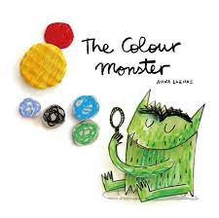
KS1: Must Read Books

Slide 5
Lower KS2
Upper KS2

Slide 6
Year 1
Year 2
Autumn
Autumn
Winter
Winter
Summer
Summer

Slide 7
Year 3
Year 4
Autumn
Autumn
Winter
Winter
Summer
Summer

Slide 8
Year 5
Year 6
Autumn
Autumn
Winter
Winter
Summer
Summer

Slide 9
Which type of reader are you?
A Book Moth
(Arabic/ Polish/ Czech/ Estonian)
A Page Mage
(Croatian)
A Bookworm
(English/ Russian/Serbian)
A Book Rat
(German/ Bulgarian)
A Book Eater
(Greek)
A Book Weevil
(Vietnamese/ Japanese)
A Library Mouse /Rat
(Italian /Spanish)
A Reading Horse
(Danish)
An Ink Drinker (French)

