Slide 1
Year 6 Arithmetic Workshop for parents

Slide 2
30 minutes
36 questions
40 marks
Progressively more difficult as children work through the paper.

Slide 3
Fractions
Before working with fractions, children need to possess several skills:
Finding equivalent fractions / simplifying fractions to their lowest form.
Changing mixed numbers to improper fractions and vice versa.

Slide 4
Multiplying fractions

Slide 5
Multiplying fractions

Slide 6
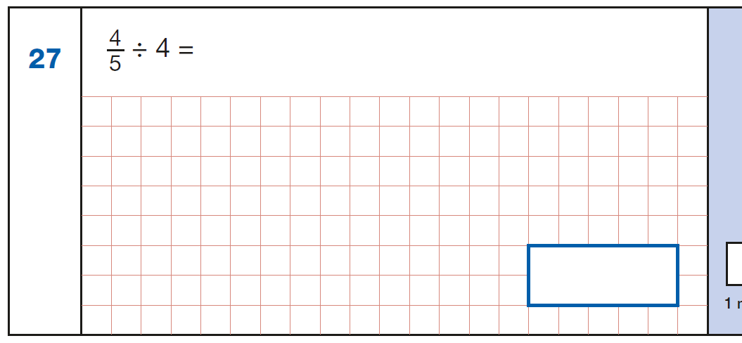
Dividing fractions

Slide 7
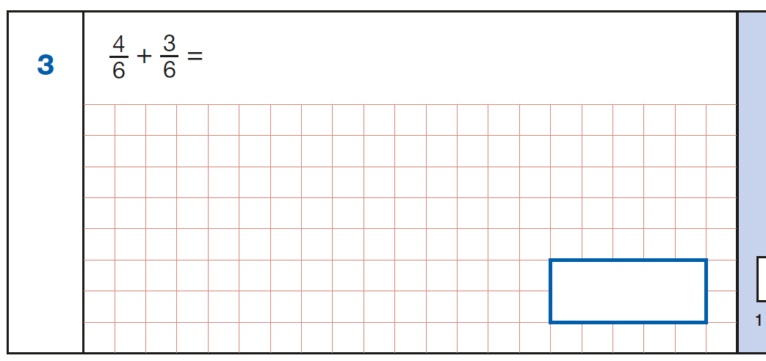
Adding fractions

Slide 8
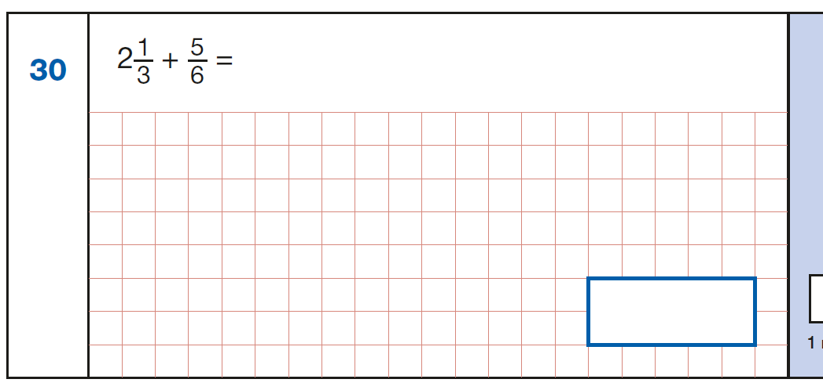
Adding fractions

Slide 9
Adding fractions

Slide 10
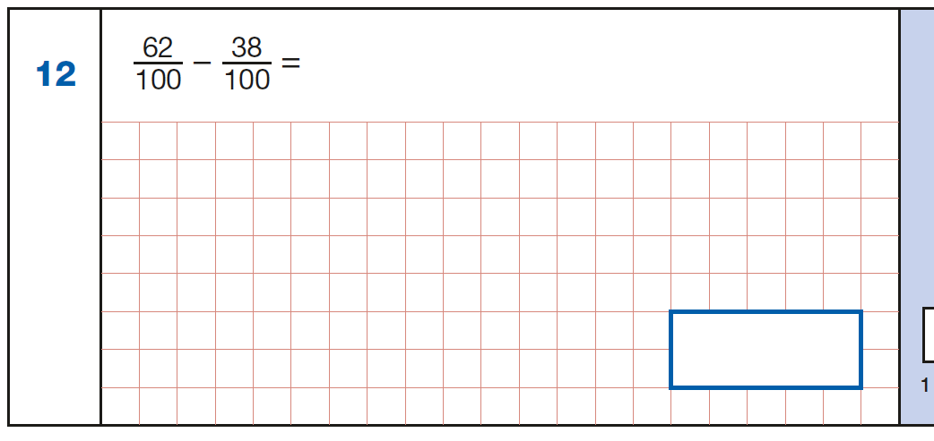
Subtracting fractions

Slide 11
Subtracting fractions

Slide 12
Subtracting fractions

