Slide 1
Read Write Inc. Phonics
Parents’ Workshop
Notes:
Notes are provided to help you lead the presentation.
Notes in italics are for your attention only.

Slide 2
Who is Read Write Inc. Phonics for?
Notes:
Read question.

Slide 3
Read Write Inc. Phonics
Nursery – Y2 (KS1)
Older children who need to‘catch-up’
Children new to English
Notes:
Using Read Write Inc. Phonics will ensure all children who come to our school learn to read:
Nursery – Y2
Older pupils who have struggled to learn to read and need to ‘catch up’
EAL pupils
Children with SEN and dyslexia also learn to read using this programme.
Teaching and learning focuses on what children already know and what they need to learn next in order to make best possible progress - by stage not age.

Slide 4
What is phonics?
Notes:
Read question.

Slide 5
Phonics
Sounds
Graphemes (letters to you and me!)
Notes:
The English language is very complex.
Phonics is the method of teaching reading through the identification of sounds and graphemes.
Click. All words are made up of sounds e.g. in ‘mat’ we have the sounds ‘m’, ‘a’, ‘t’.
Click A grapheme is another name for the letters we use to write the sound. Write the letters ‘m’ ‘a’ ‘t’ in the air as you say the sounds.
We teach phonics so that your children will have the tools to read any word.

Slide 6
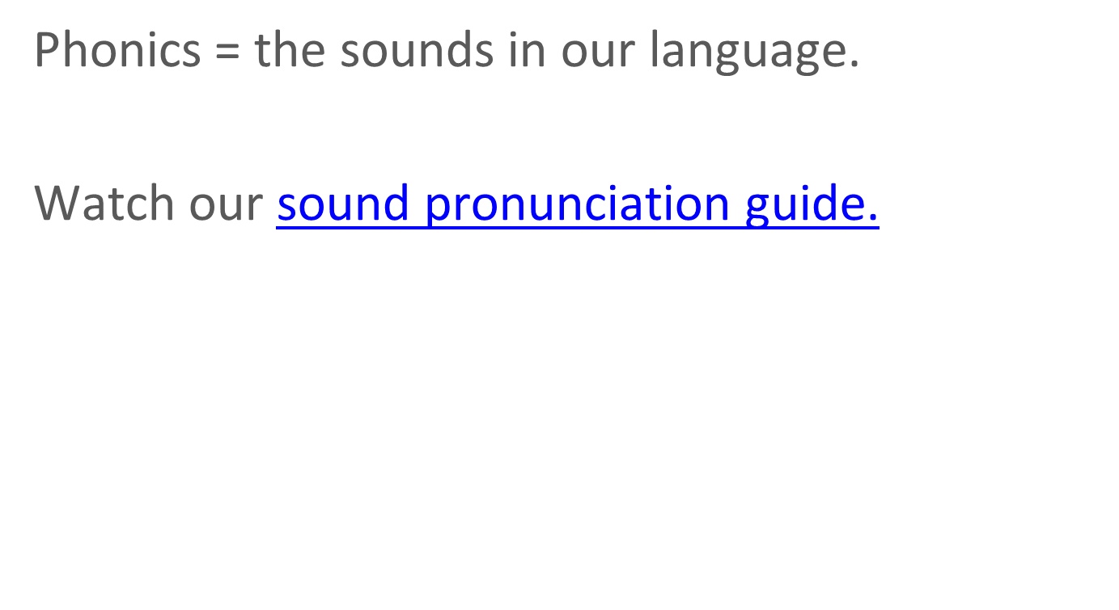
Pure Sounds
http://www.ruthmiskin.com/en/resources/sound-pronunciation-guide/
Notes:
We teach using pure sounds.
We use pure sounds (‘m’ not’ muh’, ’s’ not ‘suh’, etc.) so that your child will be able to blend the sounds into words more easily.
Children need to know sounds – not letter names – to read words.
This video of Sylvie – available on the website – demonstrates how to talk in pure sounds. Play video.

Slide 7
What is Read Write Inc. Phonics?
Notes:
Read question.

Slide 8
English alphabetic code
44 sounds
Over 150+ graphemes
One of the most complex alphabetic codes in the world.
Notes:
In English we have more than 150 ways to represent 44 sounds, using the 26 letters in the alphabet.
This means we have to group letters together to write some sounds. Show with a grapheme such as ‘igh’.
This makes our language one of the most complex in the world!

Slide 9



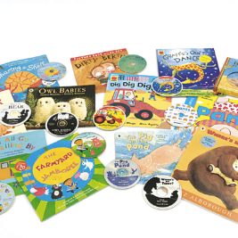







Systematic approach
sat
mat
p
d
sad
i
t
n
Notes:
Read Write Inc. Phonics is a programme that uses systematic phonics to teach all children to read.
It lasts 2-3 years for most children - if they start to learn to read in the Reception class.
Click – We teach the sounds first – in a specific order.
Click – We then teach your children to blend those sounds together in order to read words
Click – The children read words in the matched Storybooks. Each Storybook is carefully matched to the sounds they can already read - setting them up for success.
Click – We read to children ‘real’ books’. Once they have learnt to read, they will be able to independently read these books for themselves.

Slide 10
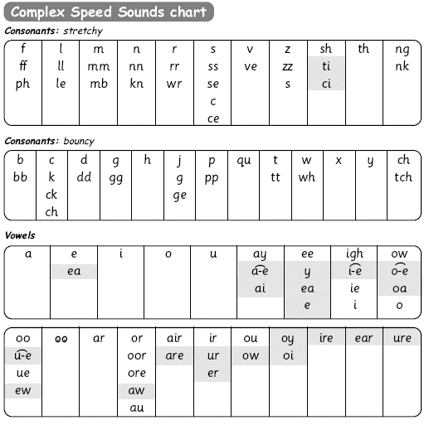
Speed Sounds chart
Notes:
We use this Speed Sounds chart in Phonics lessons.
It shows the most common graphemes for each sound.
Each box is a sound box showing different ways to read and write the sound. Demo the ‘f’ sound box with examples of words ‘fun’, ‘huff’, ‘photo’ and the ‘or’ sound box with examples of words ‘or’, ‘door’, ‘more’, ‘dawn’, ‘author’.

Slide 11
How does Read Write Inc. use phonics to teach reading?
Notes:
Read question.

Slide 12
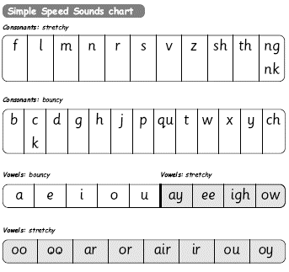
Simple Speed Sounds
Notes:
Phonics makes learning to read easy for children because we start by teaching them just one way of reading and writing every sound. Here they are on the Simple Speed Sounds chart.
We teach Set 1 sounds first - (sounds as far as a e i o u) and then Set 2 (the shaded sounds ay - oy).
Use MTYT to teach each of the pure sounds to parents.

Slide 13



Blending using Fred Talk
p
sat
d
mat
i
t
sad
n
Notes:
Once the children know the pure sounds, we teach them to blend sounds to read words. We also teach children to spell the words they learn to read.
We use Fred Talk to help children read and spell words.

Slide 14
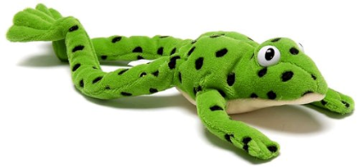
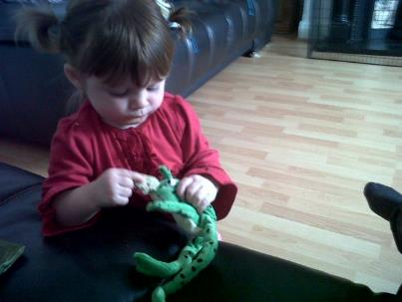
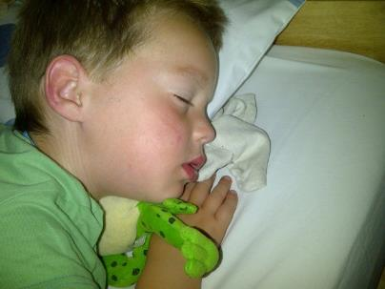
Fred Talk
Notes:
This is Fred.
He is a frog who can only speak in sounds, and we call this Fred Talk. For example ‘m’ ‘a’ ‘t’, ‘l’ ‘u’ ‘n’ ‘c’ ‘h’.
He helps children sound out words so they can read and spell.
MTYT some examples with the parents. For example ‘m’ ‘a’ ‘t’ mat, ‘s’ ‘a’ ‘t’ sat.
Click. Fred is our friend!

Slide 15
Complex Speed Sounds chart
Notes:
Once they can Fred Talk and blend sounds into words from the simple chart, we teach them Set 3 sounds on the complex chart – the other ways of reading and writing each sound so that they can soon read anything.

Slide 16



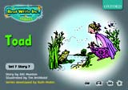
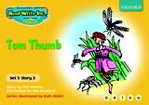
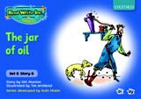
Storybooks
Notes:
Alongside learning each set of sounds, they read Storybooks that only contain the sounds and words they can read. This sets them up to succeed in their reading.
We discuss and write about the ideas in these Storybooks.
We also teach children to read common exception words – words like ‘said’ and ‘they’.

Slide 17
What should my child read at home?
Notes:
Read question.

Slide 18
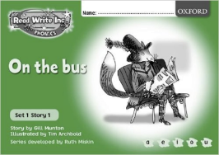
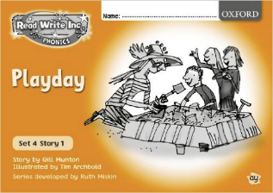
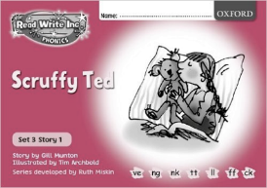
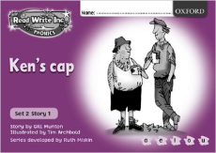
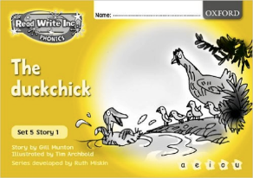
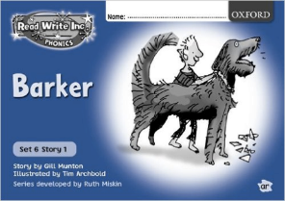
Read Write Inc. Storybooks
Notes:
Storybooks will be sent home for your children to read.
They will know all of the sounds used in the Storybook as they will bring home the book that they have already read three times in the classroom.
This means they will be able to read the text with fluency and confidence – like a storyteller. They will enjoy reading to you.
This does not mean the text is too easy for them – it means they are reading at the correct level.

Slide 19
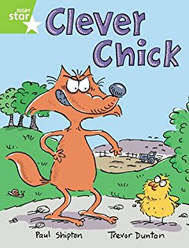
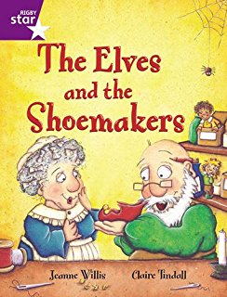

Guided Reading books
Notes:
They will also bring home a guided reading book which they will have read during small group reading sessions, outside of RWI.
They books will also be matched to your child’s phonetic ability, but they do tend to include more common exception words

Slide 20
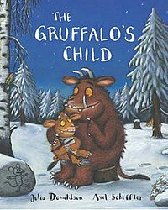
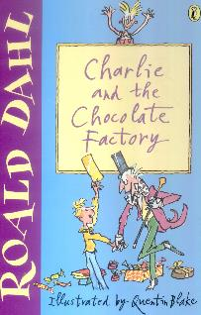
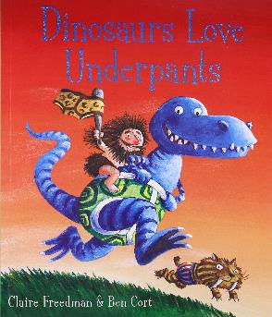
Own books
Notes:
They will also bring home a guided reading book which they will have read during small group reading sessions, outside of RWI.
They books will also be matched to your child’s phonetic ability, but they do tend to include more common exception words

Slide 21
How can I help at home?
Notes:
Read question.

Slide 22
Storytime
Read to your children
Ask lots of questions and share opinions
You're never too old, too wacky, too wild, to pick up a book and read to a child.
Dr Seuss
Notes:
One of the most important things you can do as a parent at home is read higher level texts to your child.
This helps develop an enjoyment for stories and the motivation for learning to read themselves.
Ask questions and share opinions about what you read to engage them in discussion, get them thinking about what they read and develop vocabulary.
Click and read.

Slide 23
Talking
Talk to your child as much as possible and ‘feed’ them new and ambitious vocabulary.
“Let’s eat our lunch now.”
“Let’s munch our lunch now.”
“Let’s scoff our lunch now.”
“Let’s devour our lunch now!”
Notes:
Click through and read examples to parents.
Use ambitious vocabulary with your children and encourage them to use these words for themselves in both their speech and writing. Build interesting sentences with your child.
A rich vocabulary is essential for high levels of comprehension. The more words your child has in his/her head when they come to school, the quicker they will understand when they read, e.g.
“You’re looking pleased… not just pleased but delighted!” (thrilled/ecstatic/euphoric! Etc)

Slide 24
Read Write Inc. lessons
Support how your child is learning to read and spell in school.
Pure sounds
Fred Talk
Notes:
It really helps to be aware of how your child is learning in the classroom – pure sounds not letter names; Fred Talk when they are reading words and Fred Fingers when they are spelling words.
Encourage your child to discuss their Phonics lessons with you and to read and discuss their storybook with you at home.
We have shared the basics of Read Write Inc. Phonics and how you can help.
There are also some online resources that you can access for free. Click through to next slide.

Slide 25
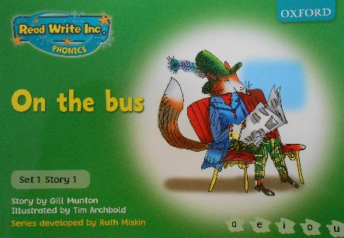
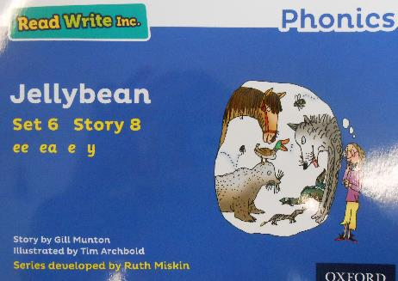

Slide 26
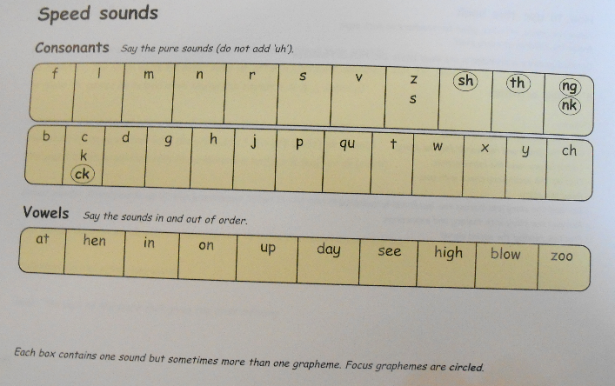
Activity 1 – Speed sounds practice – Green book

Slide 27
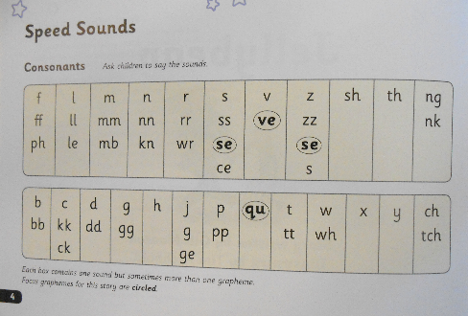
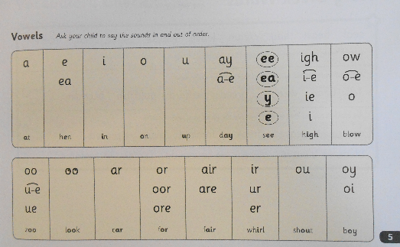
Activity 1 – Speed sounds practice – Blue book

Slide 28
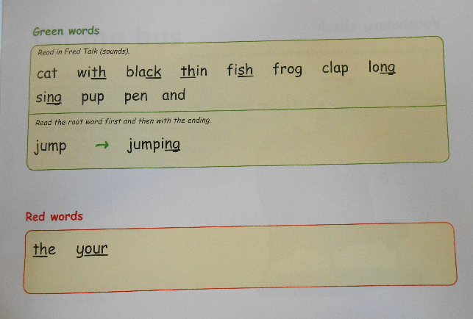
Activity 2 – Green words practice – Green book
Notes:
This activity prepares your child for reading the book. My practicing some of the common ‘blendable’ words within the story beforehand, they should be able to read the story more fluently.
Splitting words into syllables
Root words and endings

Slide 29
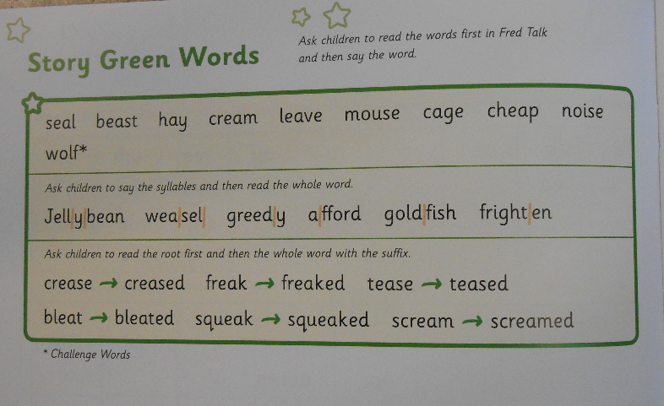
Activity 2 – Green words practice – Blue book

Slide 30
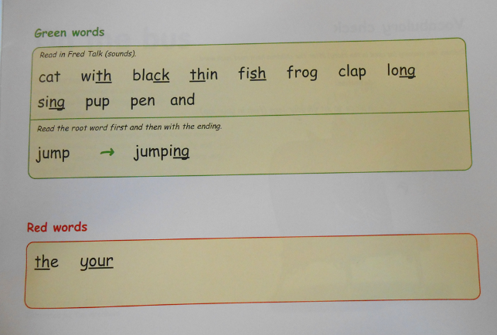
Red words practice
Notes:
Red words are those which are not entirely blendable – words like ‘said’.
These words children just have to learn.

Slide 31
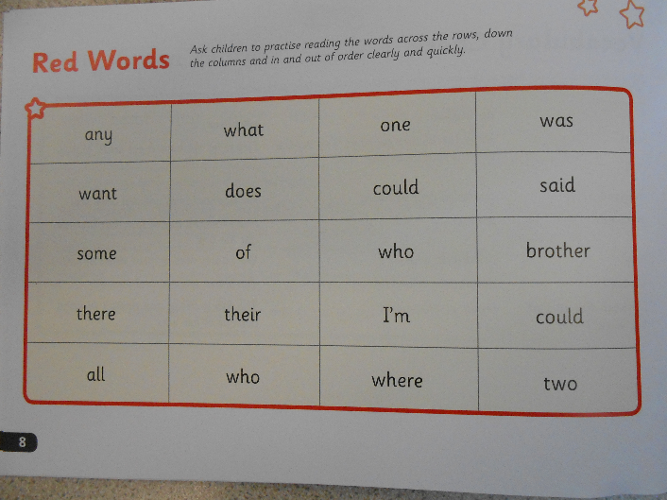
Red words practice

Slide 32
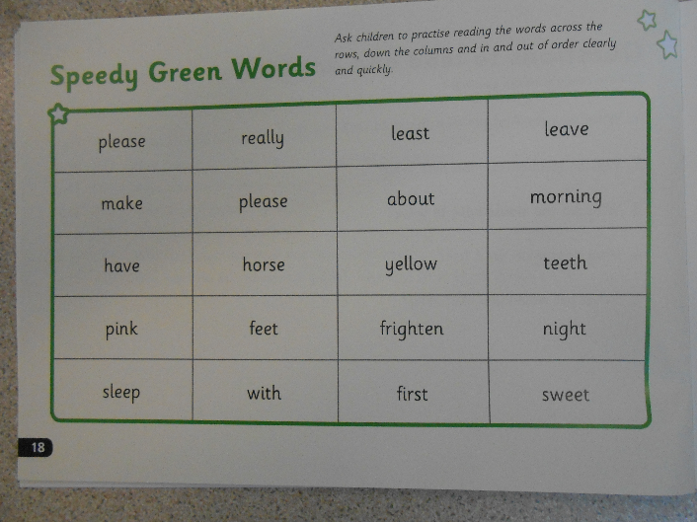
Speedy activity at the back of the book
Notes:
These words are the common green words.
Once your child is confident in reading the green words, this is a fun activity to test them, or for them to test you!

Slide 33
What if my child hasn’t got a RWI book yet?
-Children don’t start using the Storybooks until they can fully blend three or four sound words accurately and independently.
Until then, they complete ‘word time’ activities and specific homework will be sent home each week in place of a book.
Notes:
Show magnet boards

Slide 34

Notes:
Make things as fun as possible – pretend that you need your child to help teach you, use silly voices.
Take it at their pace – the activities just shown are ideal for nights when you haven’t got much time or if your child is tired.

Slide 35
Online resources available
Ruth Miskin Parents’ Page:
http://www.ruthmiskin.com/en/parents/
Ruth Miskin Facebook:
https://www.facebook.com/miskin.education
Free e-books for home reading:
http://www.oxfordowl.co.uk/Reading/

Slide 36

Any other questions

Slide 37
Reading feeds the imagination, it expands
horizons and offers new and exciting ways of
seeing and making sense of our lives and of
the world around us.
Michael Morpurgo

