Slide 1
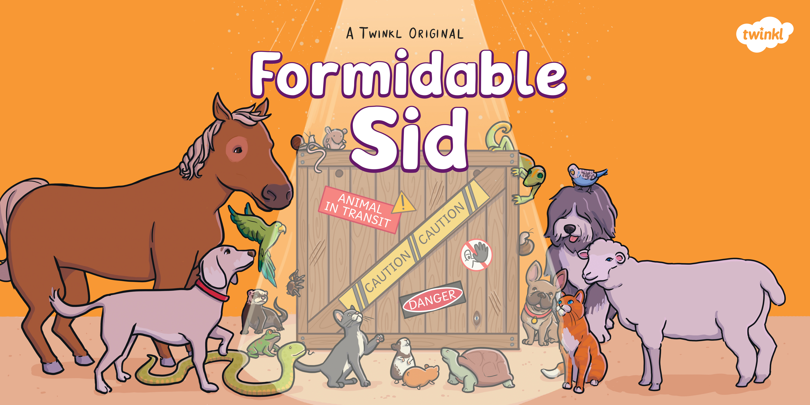

Slide 2
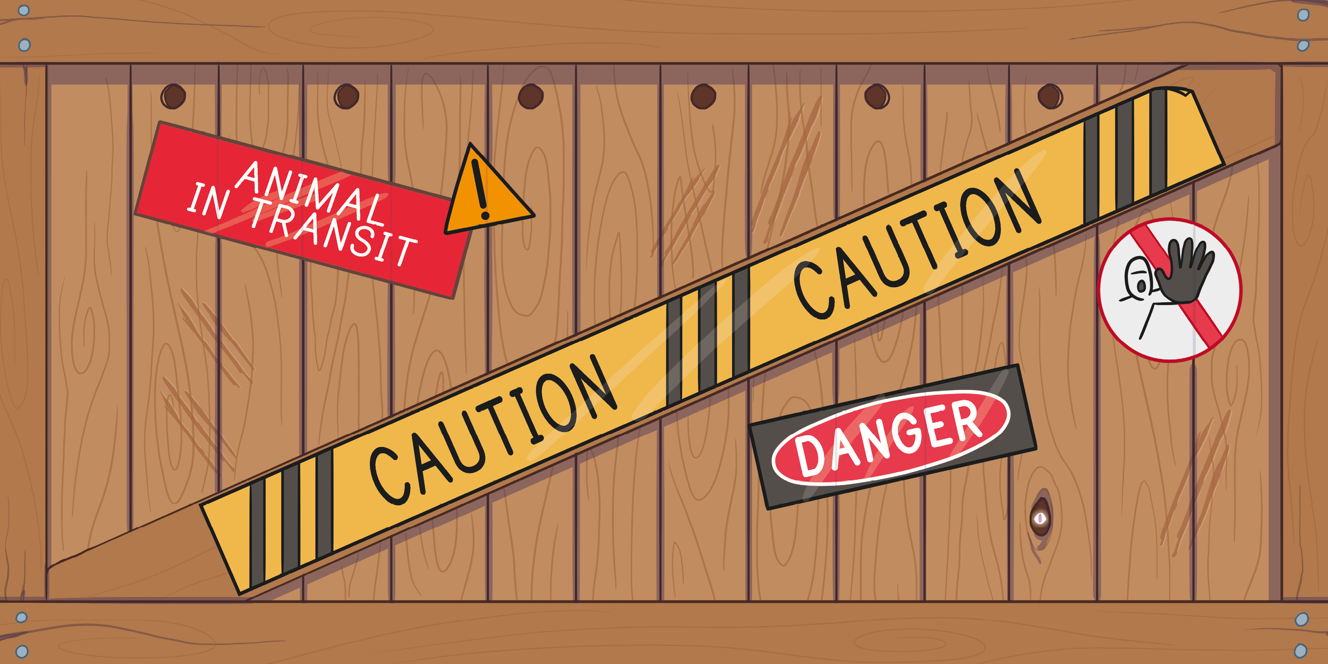

Slide 3
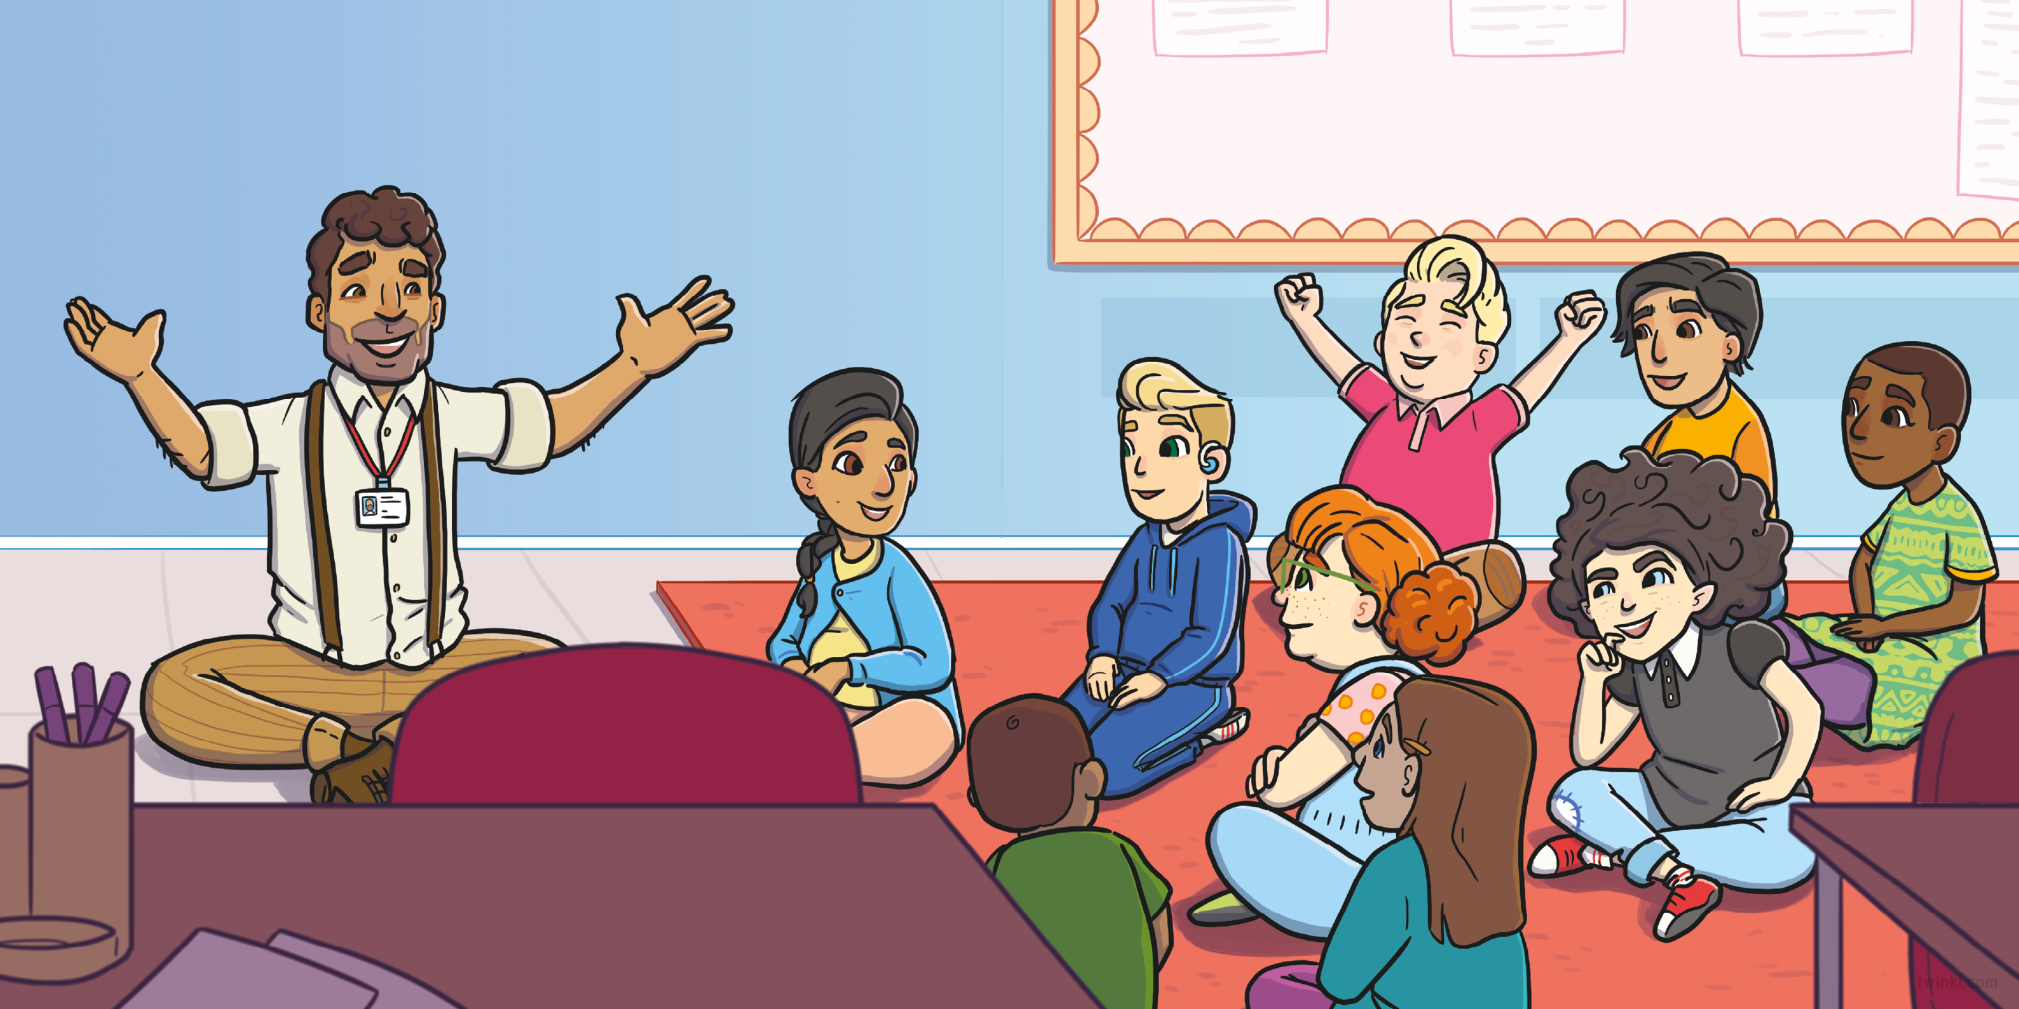
It was Monday morning and Mr Garcia had gathered Willow Class on the carpet for some exciting news.
“Each of you is allowed to bring in one of your pets from home,” he said. “I wonder what special animals we’ll get to meet.”
“Next week, we’re going to be celebrating Pet Day!” he said with a big smile.

Slide 4
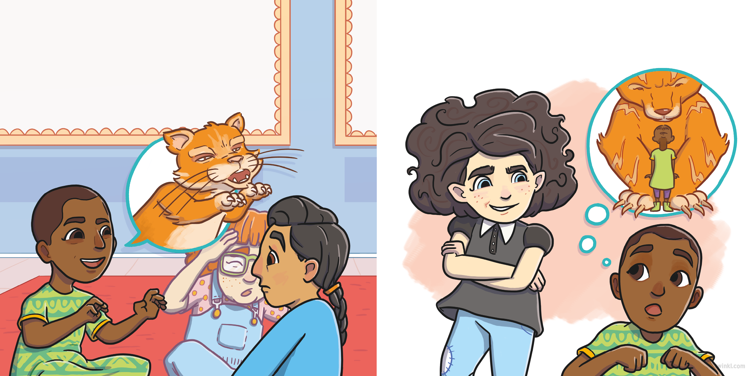
As the week went on, the children excitedly told each other all about their pets.
“That’s nothing,” said Violet. “My pet, Sid, is much fiercer than your cat. His claws are as long and sharp as a tiger’s!”
“My cat is so fierce,” said Sasha, “you’ll have to be careful of his really sharp claws!”

Slide 5
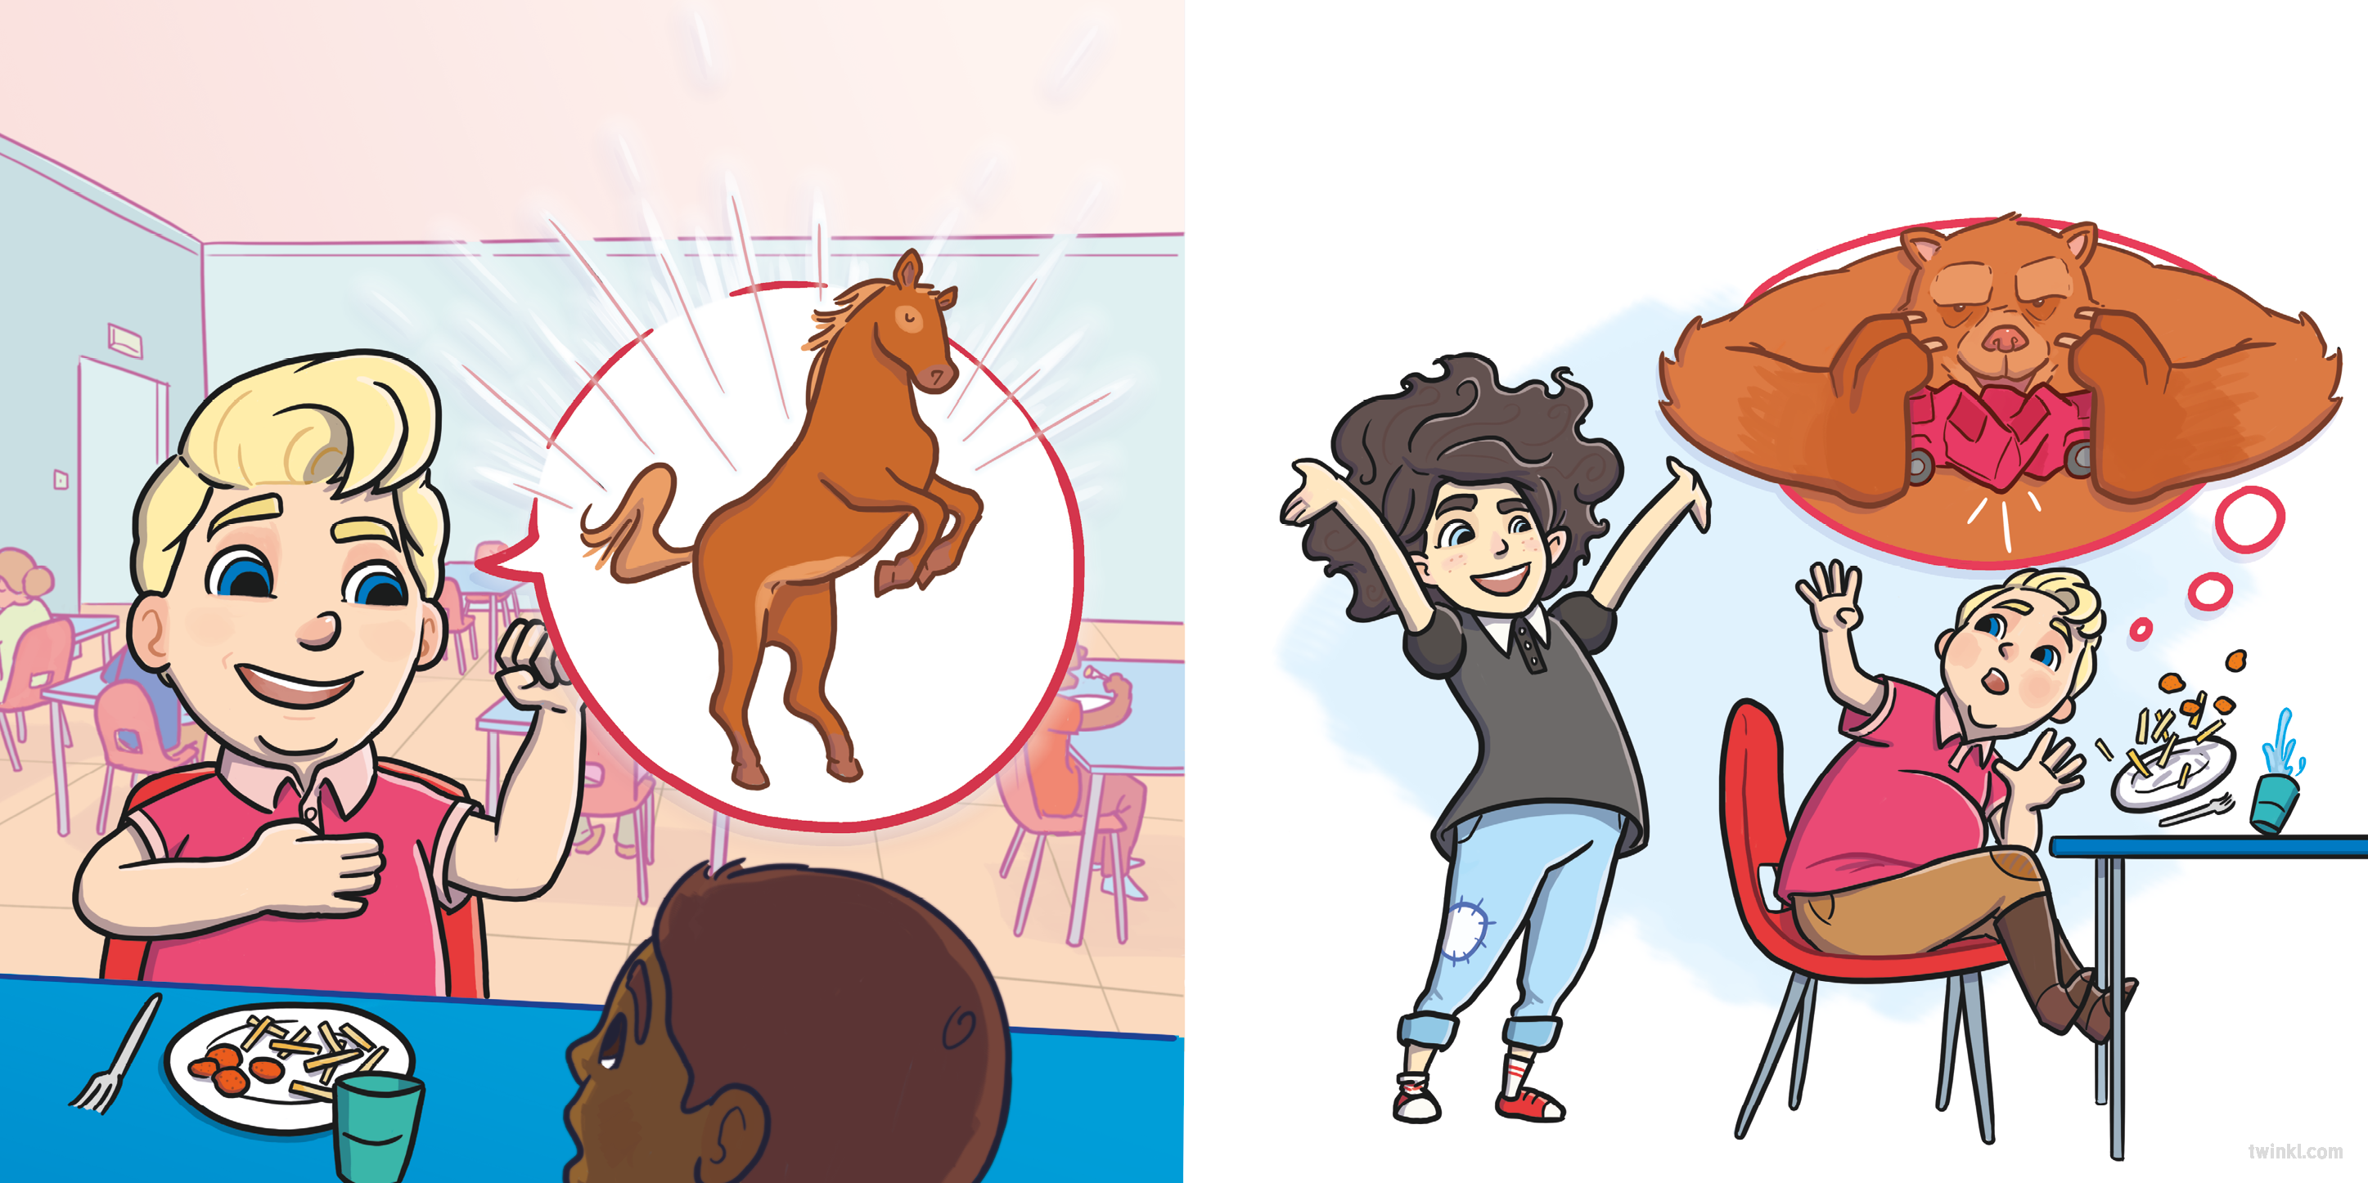
“I love my horse,” said Damian. “She’s so big and strong!”
“That’s nothing,” said Violet. “My pet, Sid, is much bigger and stronger than your horse. He could crush a car with his paws!”

Slide 6
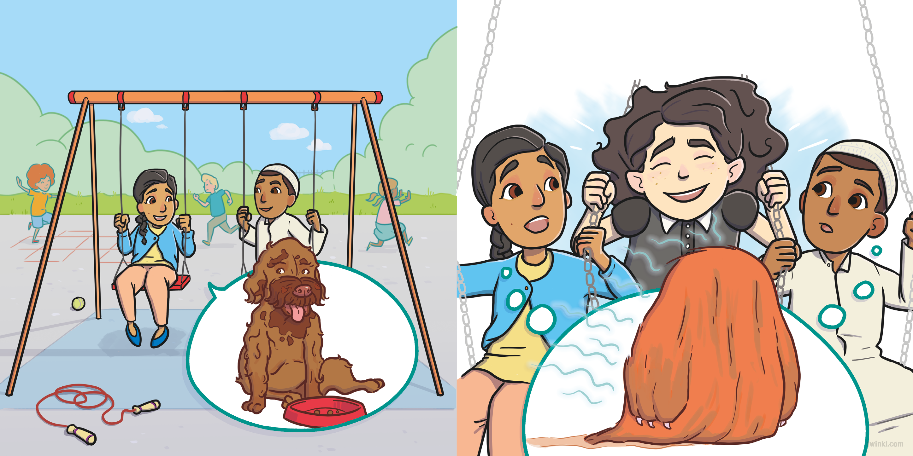
“My dog is so messy,” said Thea. “Her face gets all covered in food when she eats her dinner!”
“That’s nothing,” said Violet. “My pet, Sid, is much messier than your dog. He looks and smells like he lives in a swamp!”

Slide 7
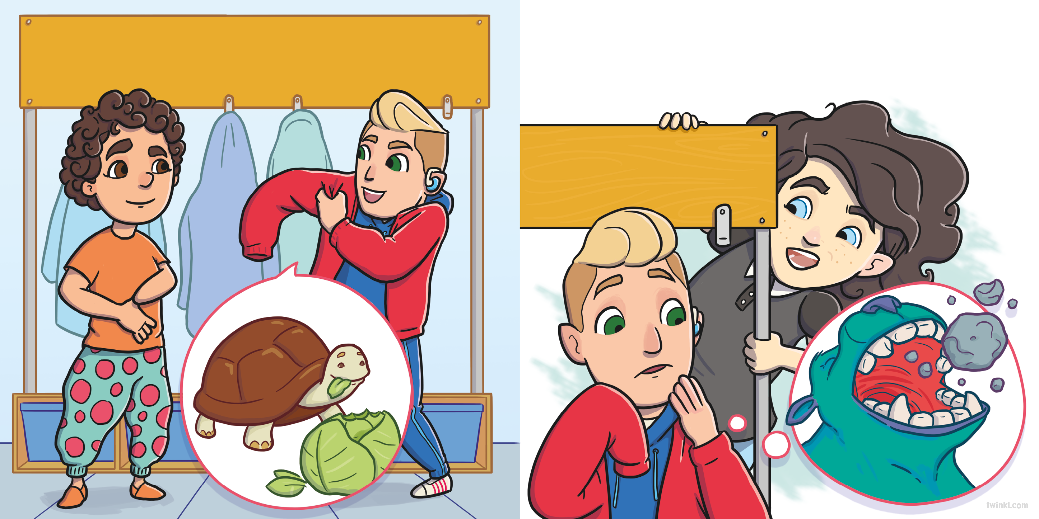
“Wait until you meet my pet tortoise,” said Riley. “He’s so greedy, he eats a whole cabbage to himself every day!”
“That’s nothing,” said Violet. “My pet, Sid, is much greedier than your tortoise. His giant teeth chomp through twenty boulders a day!”

Slide 8
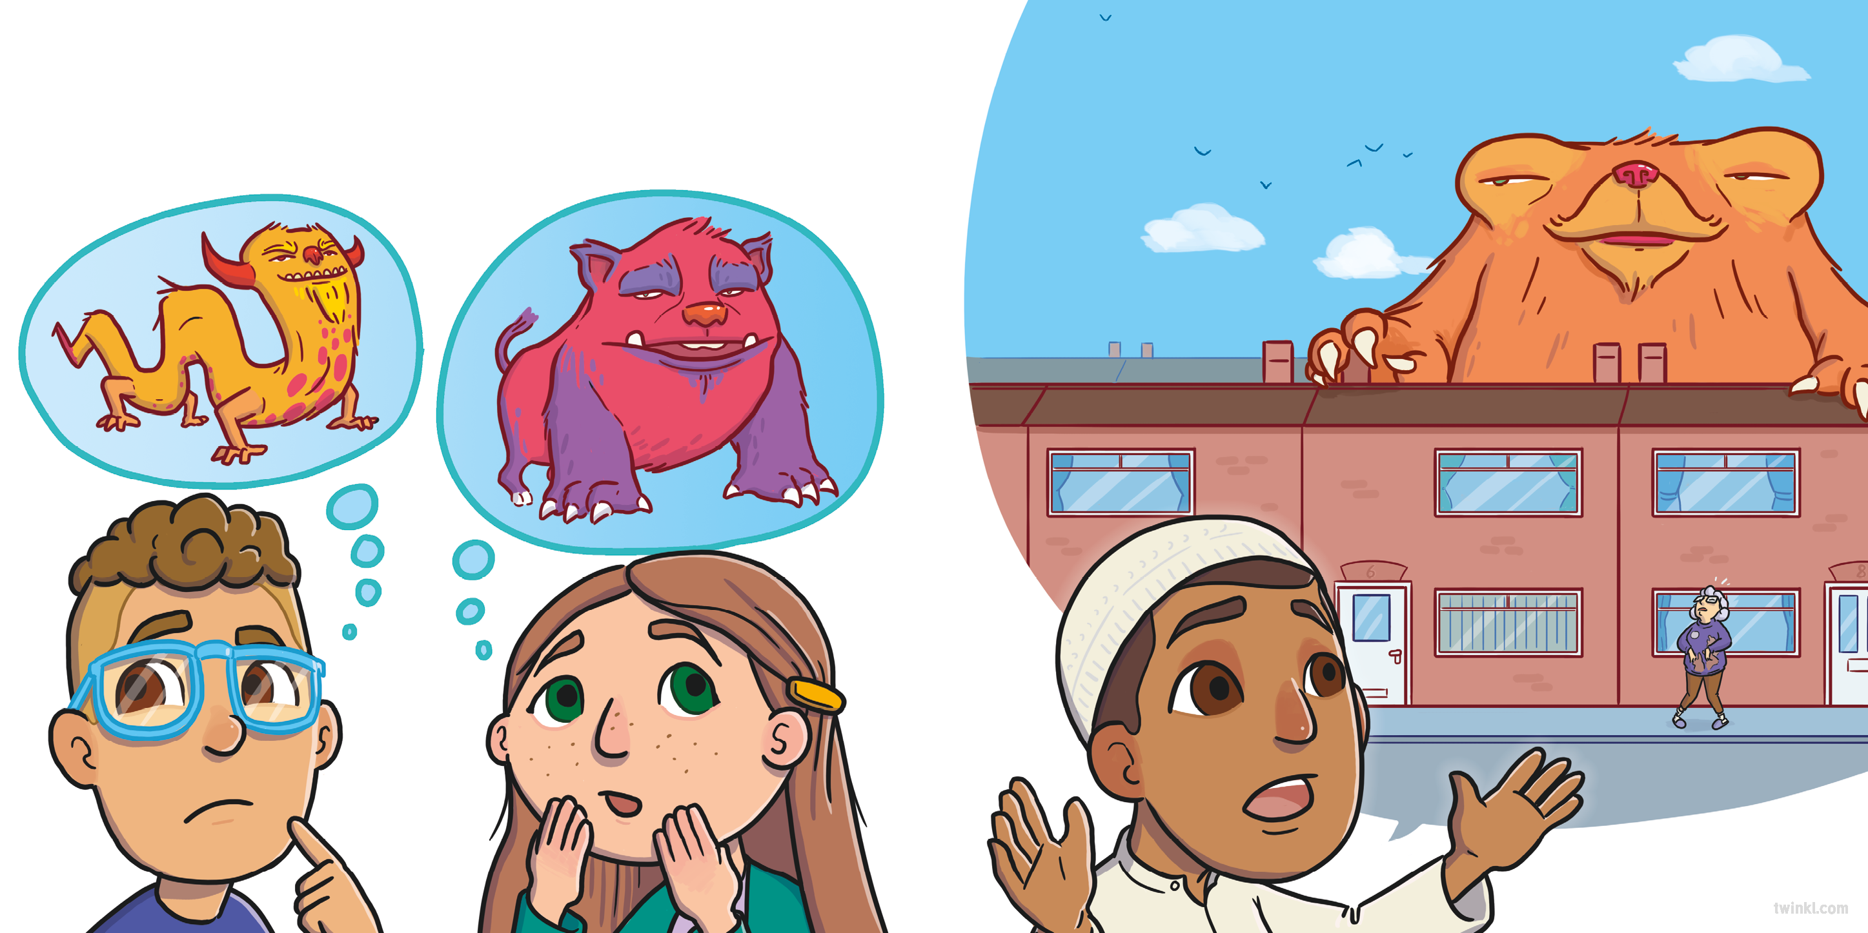
The days passed and as Pet Day started to get closer, the children worried about what terrible creature Violet would bring to school.
“I heard Sid is as big as a house!” said Jamal.

Slide 9
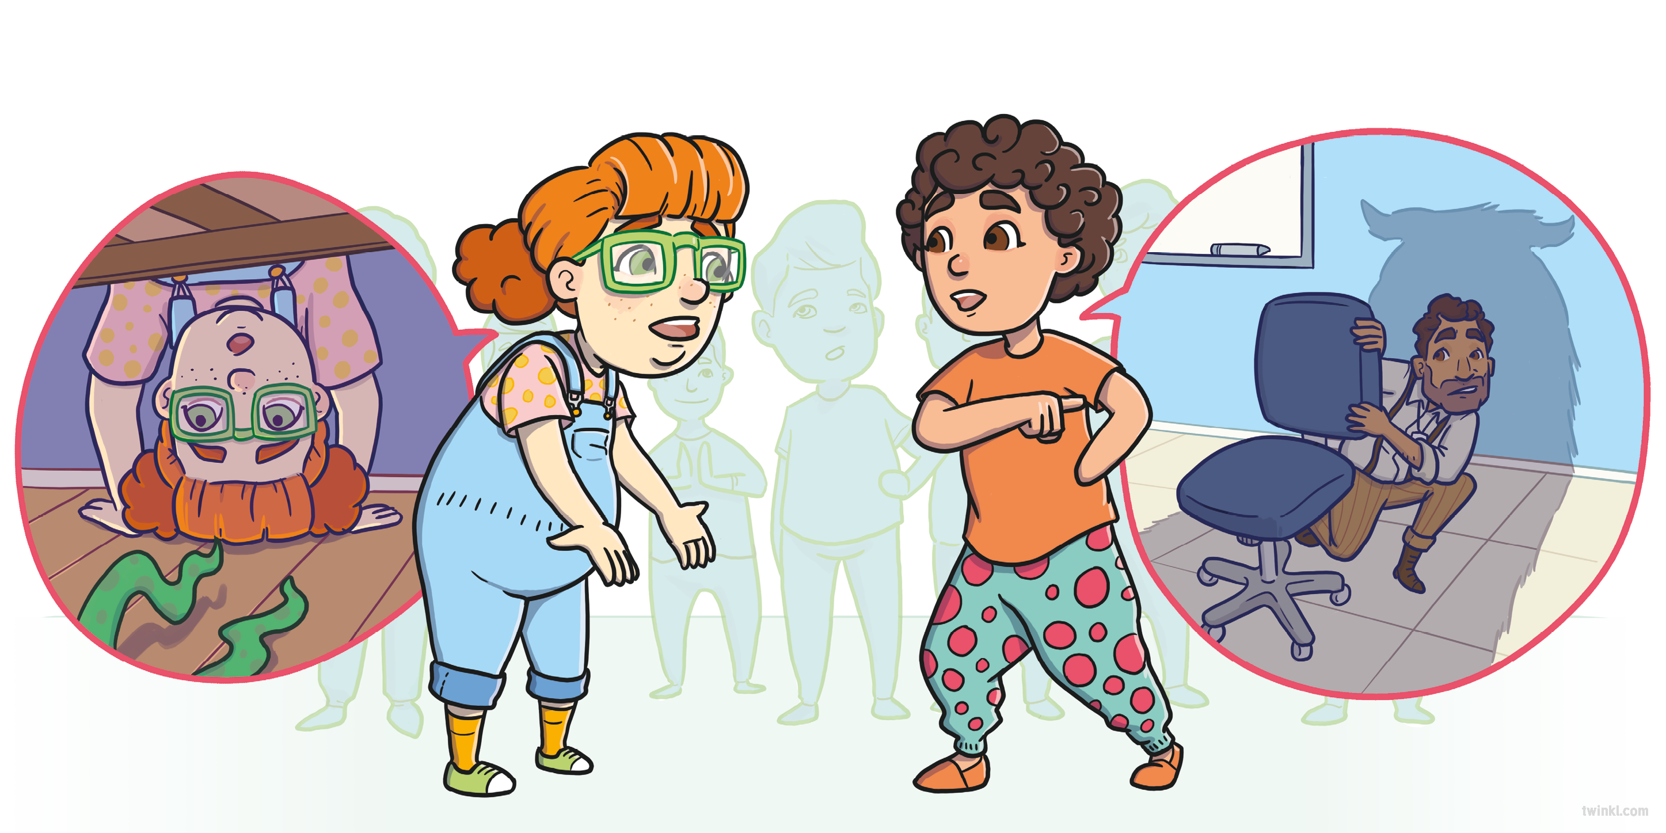
“I heard he hides under your bed waiting to eat you for dinner!” said Chloe.
“I heard even Mr Garcia is afraid of him!” said Sarah.

Slide 10
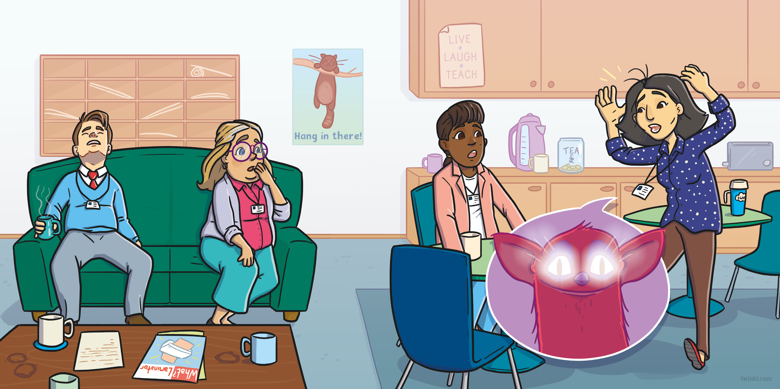
Even the teachers were talking about Sid.
“I heard he has eyes that glow in the dark!” said Miss Murphy.

Slide 11
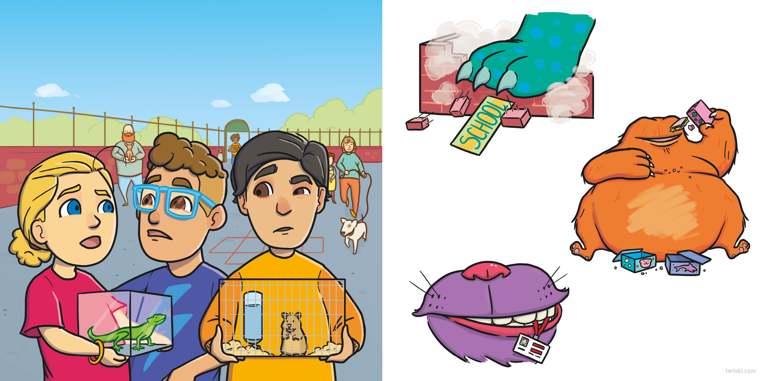
It was finally Pet Day and even though the children couldn’t wait to show off their own pets, all any of them could talk about was Violet’s mystery monster.
“What if he knocks the school down?” said Lee.
“What if he eats all of our lunches?” said Charlie.
“What if he eats all of our teachers?” said Maya.

Slide 12
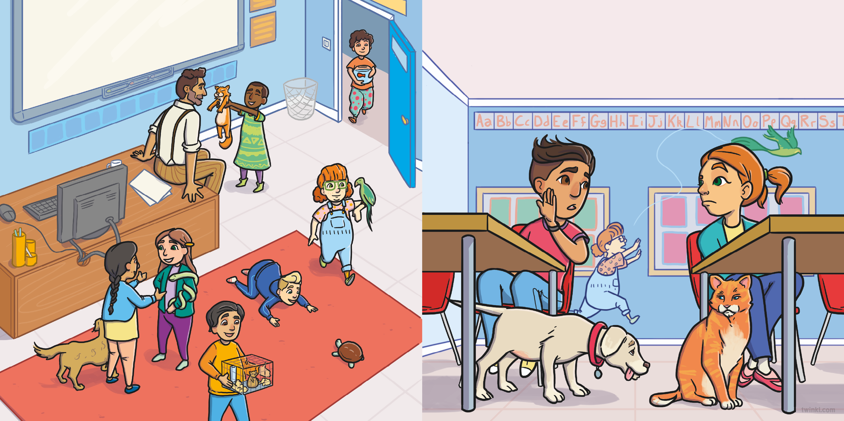
Mr Garcia called everyone into the classroom.
“Where’s Violet?” asked Enzo. “I hope Sid hasn’t gobbled her up!”

Slide 13
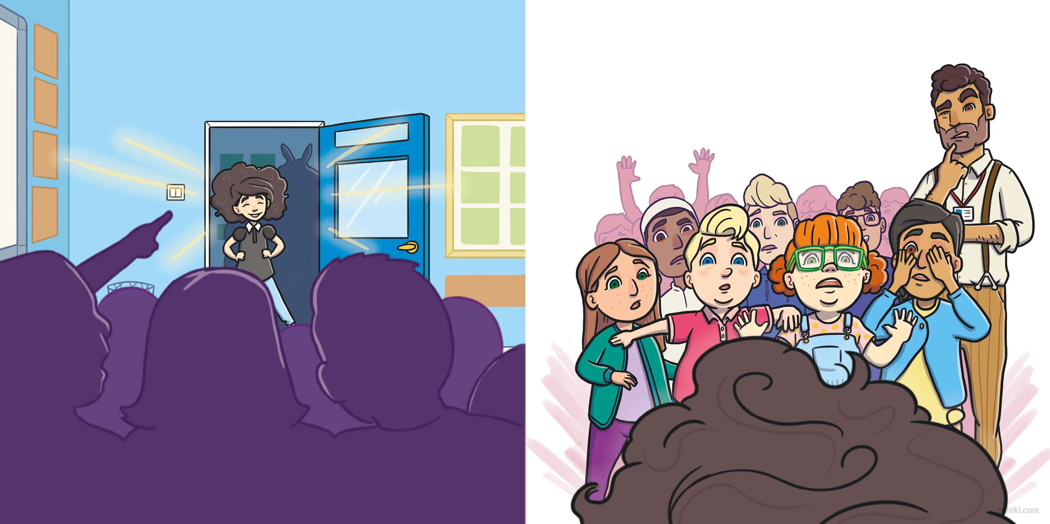
Just then, Violet stomped proudly into the classroom. Everyone gathered at the door, desperate to see what kind of creature was following behind her.
Violet’s mum followed behind,
carrying a terrifying…
hideous…
monstrous…
They waited and suddenly, Peter cried,
“I think I can see him!”

Slide 14
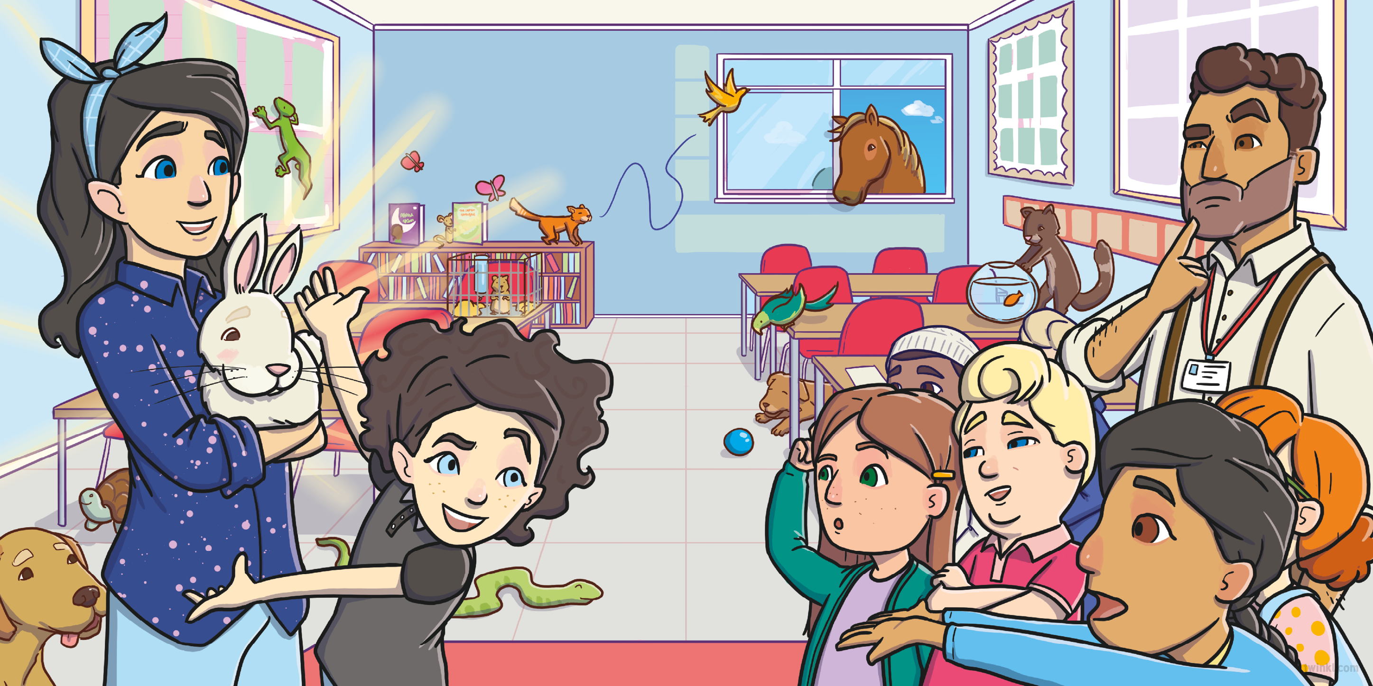
…adorable fluffy bunny!

Slide 15
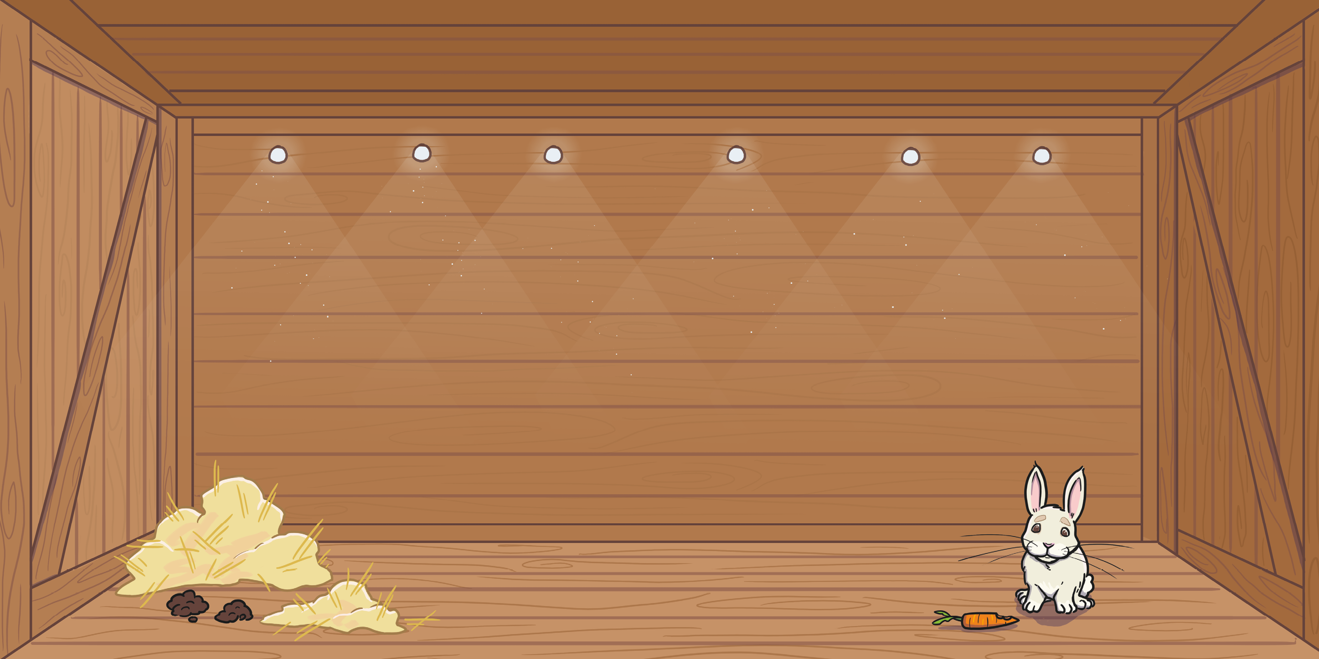

Slide 16
