Slide 1
Guidance for Video/Audio in PowerPoints
1. Open the folder and copy all the files.
2. Paste the copied files into a new folder.
3. Open the PowerPoint file, enable editing and enter presentation mode (start the slide show). Go to slide 3 and the backing track will start automatically.
Please note the embedded audio may not be compatible with early versions of PowerPoint.
You may wish to delete this slide before beginning the presentation.

Slide 3
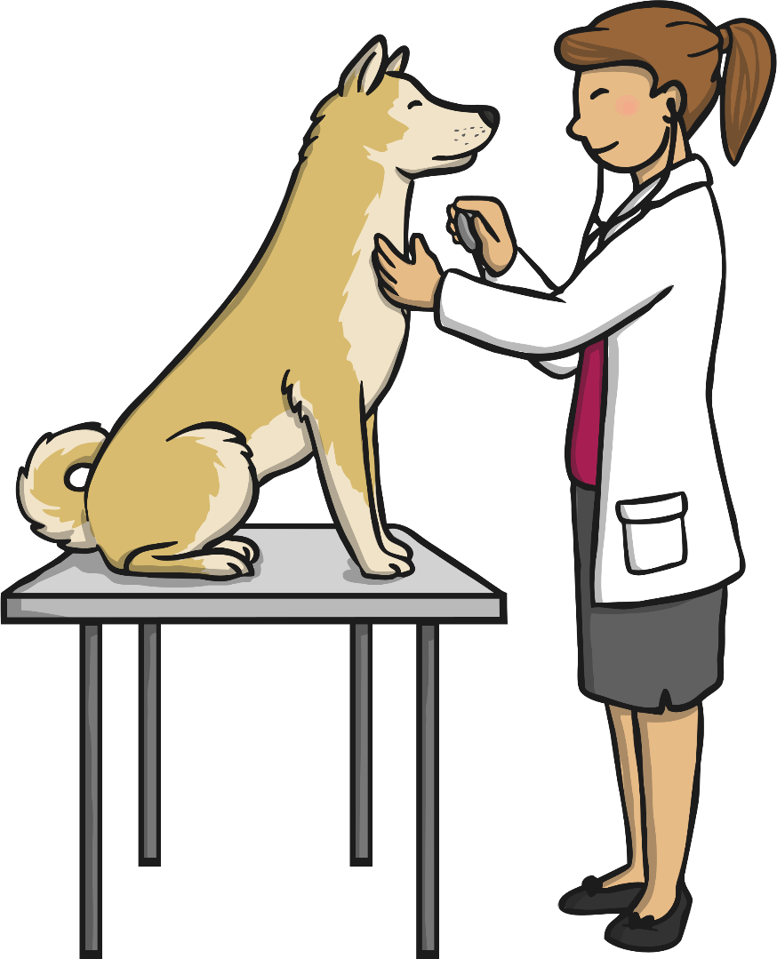
We took my dog on a little trip
To get her a microchip.
It has our address, it has our name,
It has a phone number to find us again.
We took my dog on a little trip
To get her a microchip.

Slide 4
My dog got lost last week in the park.
We searched until it was dark.
Then someone took her straight to the vet’s.
They scanned the microchip to find our address.
My dog got lost but then she was found!
She’s back home now, safe and sound.

