Slide 1
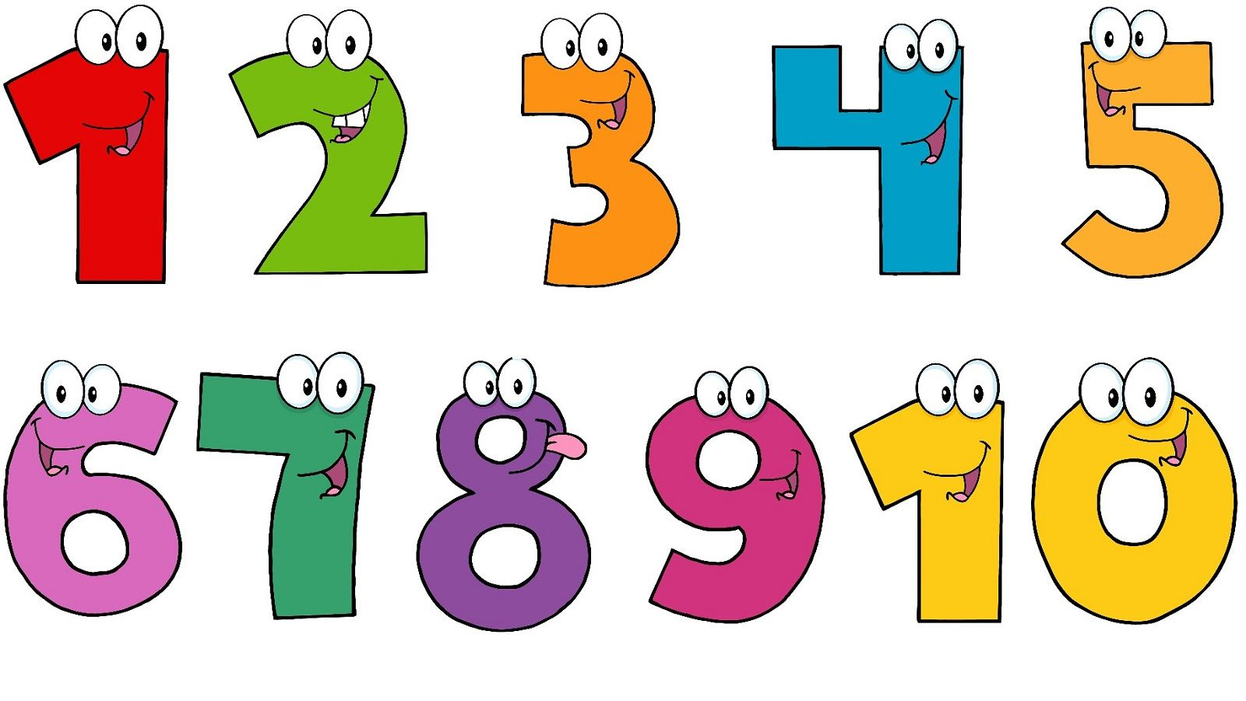
Arithmetic skills

Slide 2
Add and subtract a smaller 1 digit number
Imagine a number line in your head and count on if you are adding, count back if you are subtracting.
Remember to put the largest number in your head and use your fingers to count on.
Use the number square or number line resources attached with this weeks planning if you need to.
Use the number bonds you know to help you get faster, e.g.
57 – 4 = ……….. you know 7 – 4 = 3 so use this to help you

Slide 3
Adding and subtracting 2 digit numbers
Think back to when we were in school and we explored partitioning (splitting) two-digit numbers into tens and ones.
Watch these video clips to remind you of how we used the resources to help us:
https://www.youtube.com/watch?v=e42px1bNVLo
https://www.youtube.com/watch?v=rboeGFVD9qA
Can you remember the different ways we looked at to record / draw the tens and ones when we were in school?
Have a look at the examples on the next page to see if that helps.
If you need any more support please send us a message and we will be happy to help you.

Slide 4
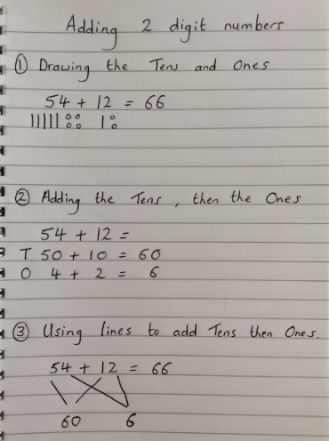
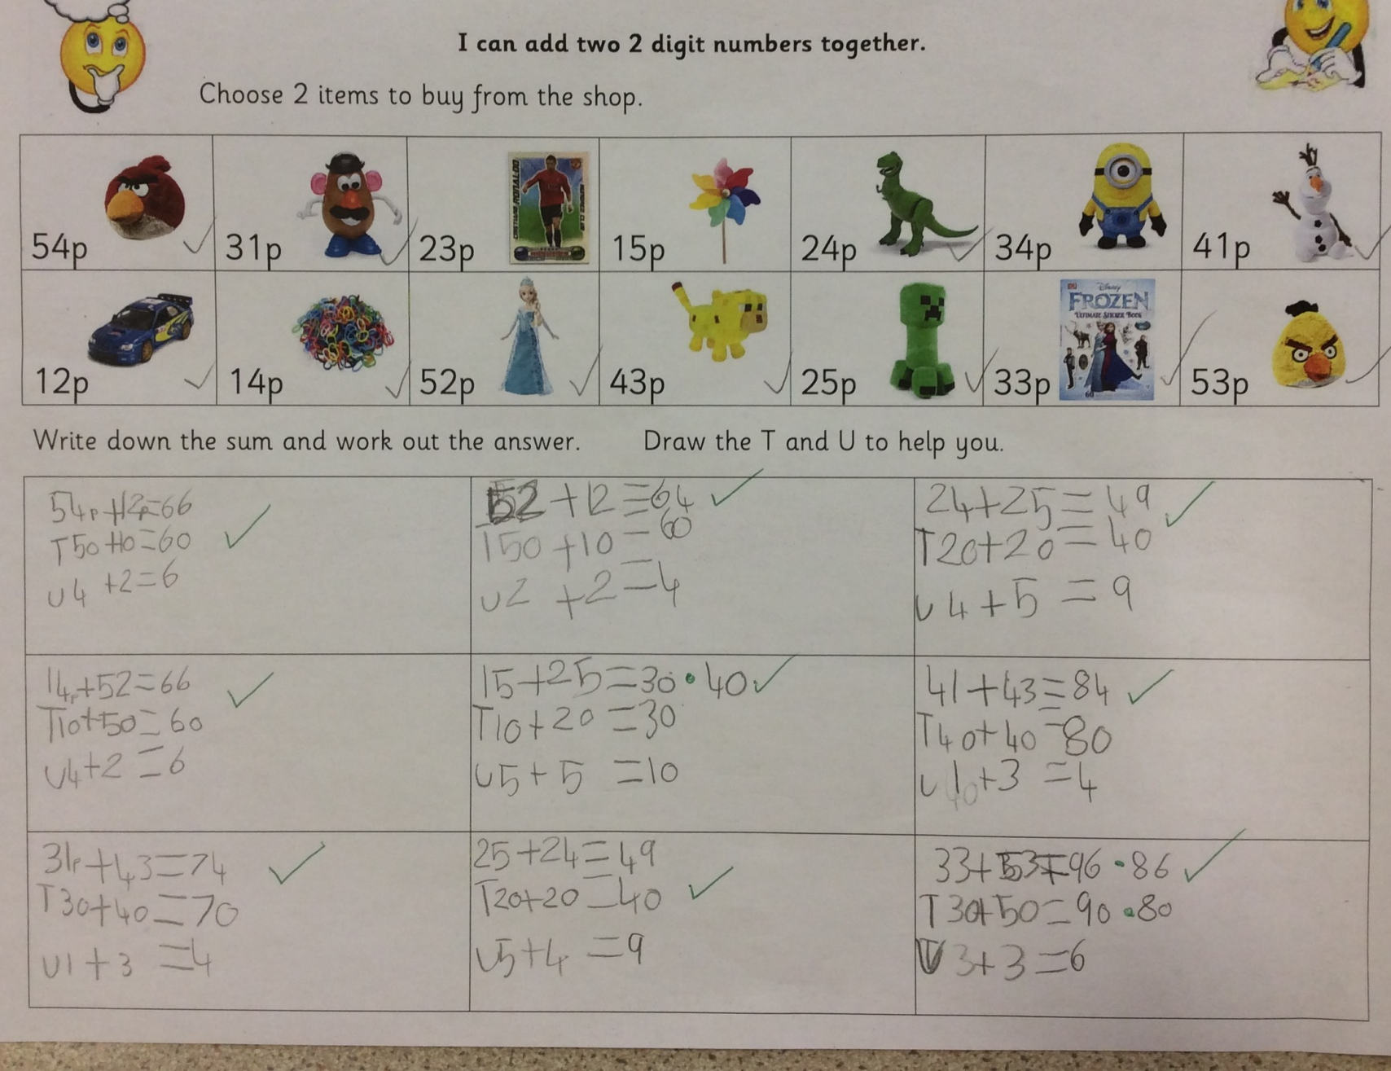
Examples????

Slide 5
Multiplication Remember to count carefully in 2’s, 5’s and 10’s. 4 x 2 = ………… 4 lots of 2 2 + 2 + 2 + 2 = Hold up 4 fingers (4 lots) and count them in groups of 2 2, 4, 6, 8

Slide 6
Division Again remember to count carefully in 2’s, 5’s and 10’s. 14 ÷ 2 = ………… 14 shared between 2 How many groups of 2 in 14? Count in groups of 2 on your fingers until you reach 14 2, 4, 6, 8, 10, 12, 14

Slide 7
Doubles and halves
Remember doubles and halves are the opposite of each other so use this to help you:
Double 6 ---- 6 + 6 = 12 half of 12 = 6
Double 8 ---- 8 + 8 = 16 half of 16 = 8
Double 3 ---- 3 + 3 = 6 half of 6 = 3

Slide 8
Arithmetic Challenges
We have included 2 lots of daily challenges as we know some of you love lots of maths activities to do at home, but please don’t feel you have to complete both.
Try these online games to help you develop your arithmetic skills too:
https://www.topmarks.co.uk/maths-games/hit-the-button
https://ttrockstars.com/
Log in to Espresso and play some of the games to help you develop your arithmetic skills too https://www.discoveryeducation.co.uk/
Username – student22697 password – aspass
Key Stage 1 – Maths
Please look at the addition and subtraction activities and the Multiplication and division activities.

