Slide 1
Allanson Street Primary
READ
Virtual Library

Slide 2
EYFS: Must Read Books

Slide 3
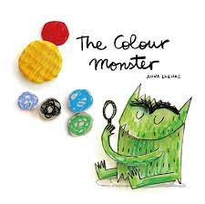
KS1: Must Read Books

Slide 4
Lower KS2
Upper KS2

Slide 5
You can be anything!
Celebrating Diversity

